Slide 1

Stage 3 Accuracy is Incidental Course Designer: Eric Beerbaum
Accuracy is Incidental is a 26 round, 130 point Comstock medium course. There are 12 USPSA targets and 2 steel targets. The best two hits per paper target will score, steel must fall to score. The start signal is audible.
The Handgun start position is standing outside the shooting area with heels touching box A. Handgun is loaded and holstered with wrists below belt. The PCC start position is standing outside the shooting area with heels touching box A. PCC loaded with stock touching belt.
On the audible start signal, engage targets from within the shooting areas.

Slide 2
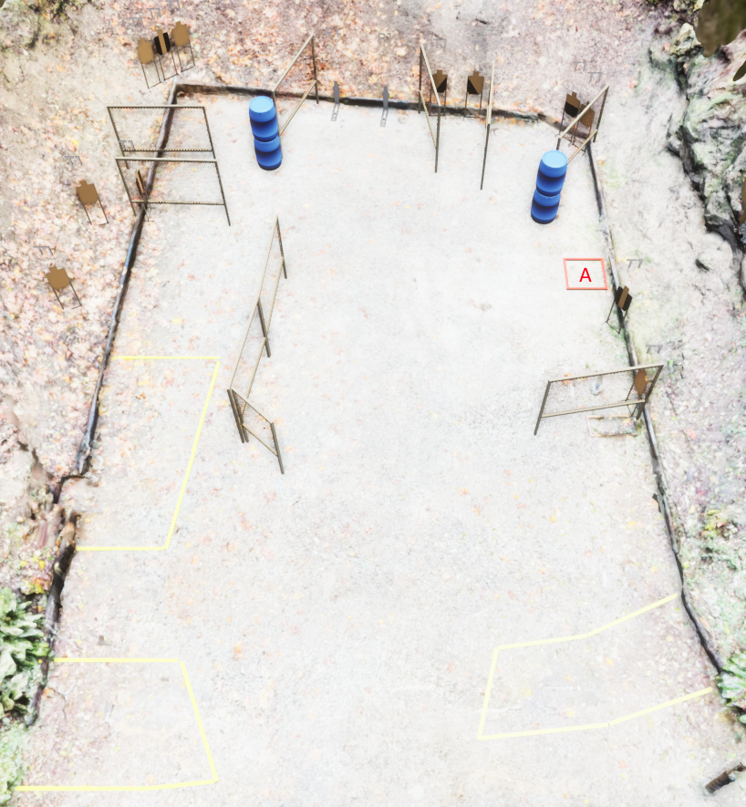
 | Stage 3 Accuracy is Incidental Course Designer: Eric Beerbaum

